Slide 1
Convolutional Sparse Coding
Optimization Methods and Application

Slide 2
Parsing the Title
Convolutional
Sparse
Coding

Slide 3
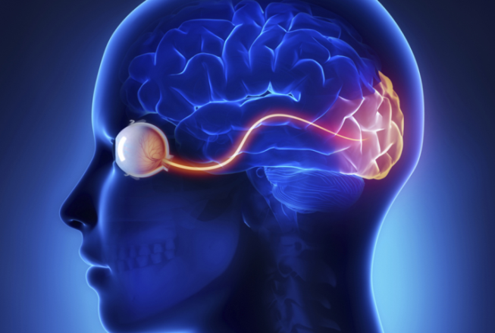
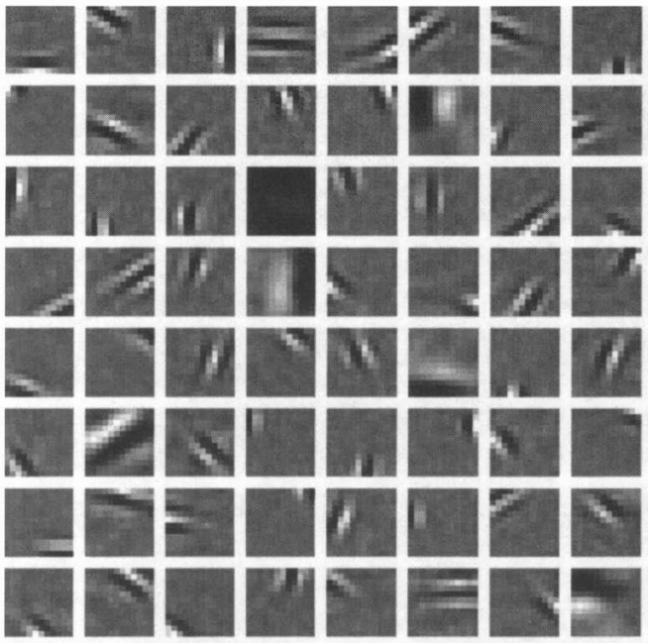
Why Patch Coding?
Modeling receptive fields in human vision
Primary Visual Cortex selective for local orientation
Later Processing Stages
Corners
junctions
more extensive contours
➔ shapes, forms, and objects

Slide 4


How to encode this image?

Slide 5
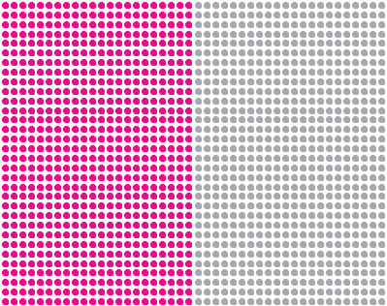
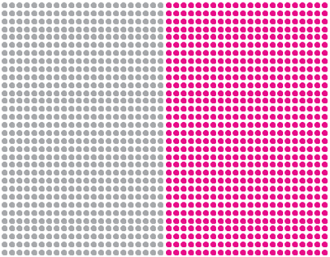
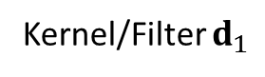
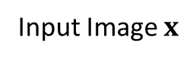
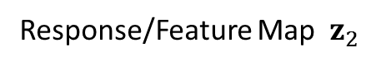
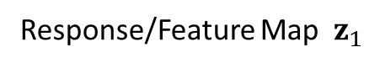
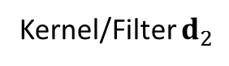
How to encode this image?
Response/Feature Map $z_{1}$
Kernel/Filter $d_{1}$
Input Image $x$
Response/Feature Map $z_{2}$
Kernel/Filter $d_{2}$

Slide 6
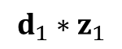
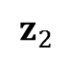
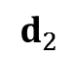
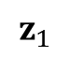
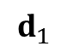
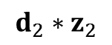
How to encode this image?
$$d_{1}$$
$$d_{2}$$
$$z_{1}$$
$$z_{2}$$
$$d_{1}∗z_{1}$$
$$d_{2}∗z_{2}$$

Slide 7
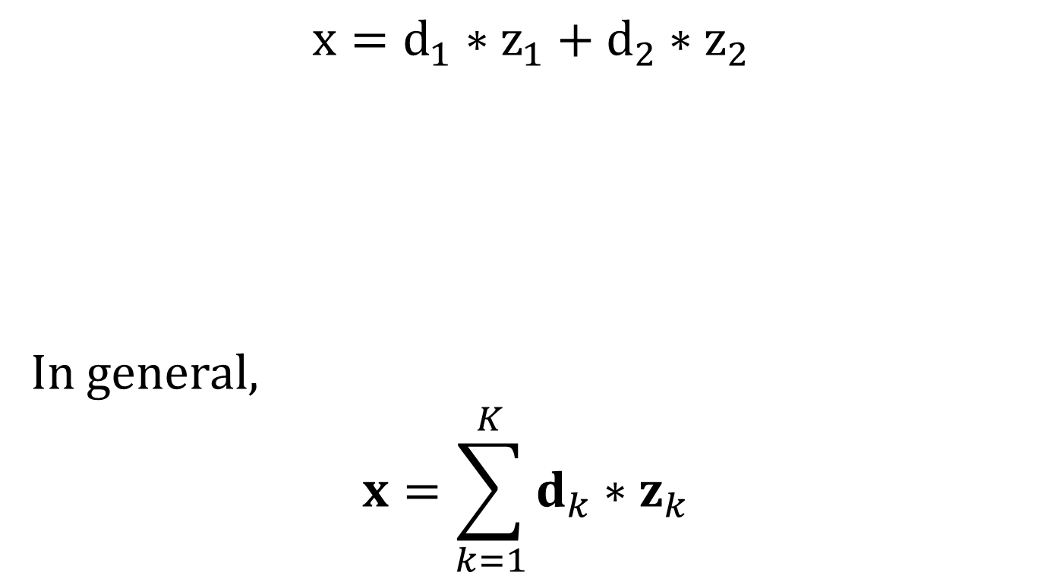
Convolutional Based Representation
$$x=d_{1}∗z_{1}+d_{2}∗z_{2}$$
In general,
$$x=\sum_{k=1}^{K}{d_{k}∗z_{k}}$$

Slide 8

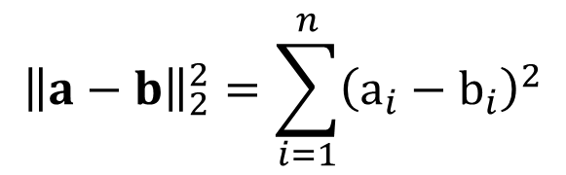

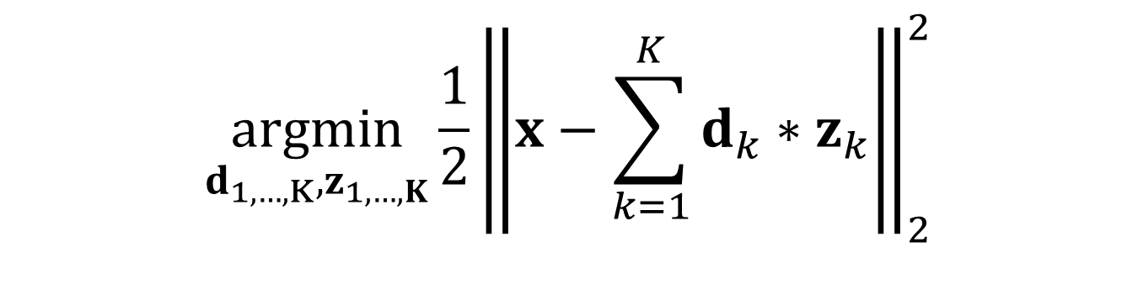
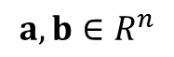
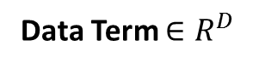
Convolutional Coding
$$\underset{d_{1,…,K},z_{1,…,K}}{argmin}{\frac{1}{2}{\left\|x−\sum_{k=1}^{K}{d_{k}∗z_{k}}\right\|}_{2}^{2}}$$
Data Term $∈R^{D}$
Convolutional K$ernel∈R^{M}$
F$eature Map∈R^{D}$
Minimize the square of the $L_{2}$ norm of the difference
$${\left\|a−b\right\|}_{2}^{2}=\sum_{i=1}^{n}{{\left(a_{i}−b_{i}\right)}^{2}}$$
$$a,b∈R^{n}$$

Slide 9
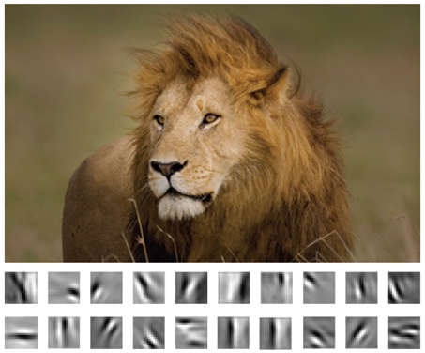
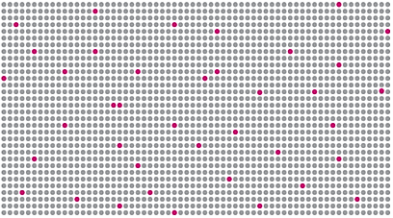
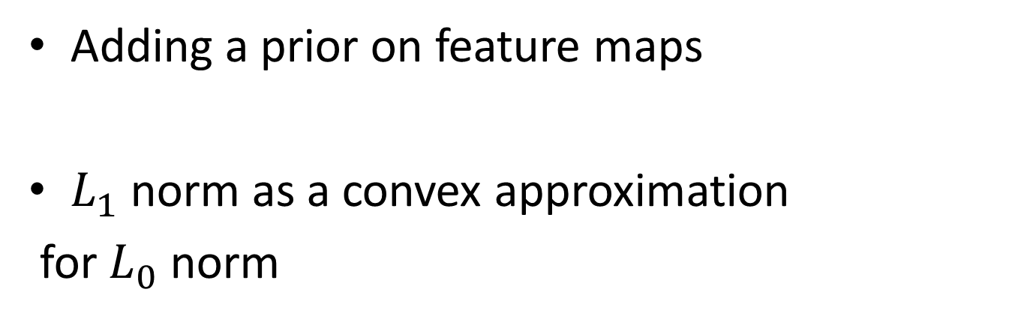
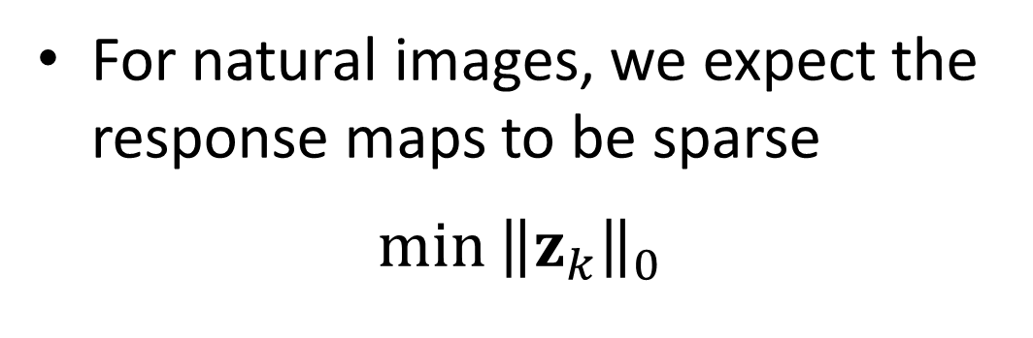
Sparse Prior on Feature Maps
For natural images, we expect the response maps to be sparse
$$\min{{\left\|z_{k}\right\|}_{0}}$$
Adding a prior on feature maps
$L_{1}$ norm as a convex approximation
for $L_{0}$ norm

Slide 10
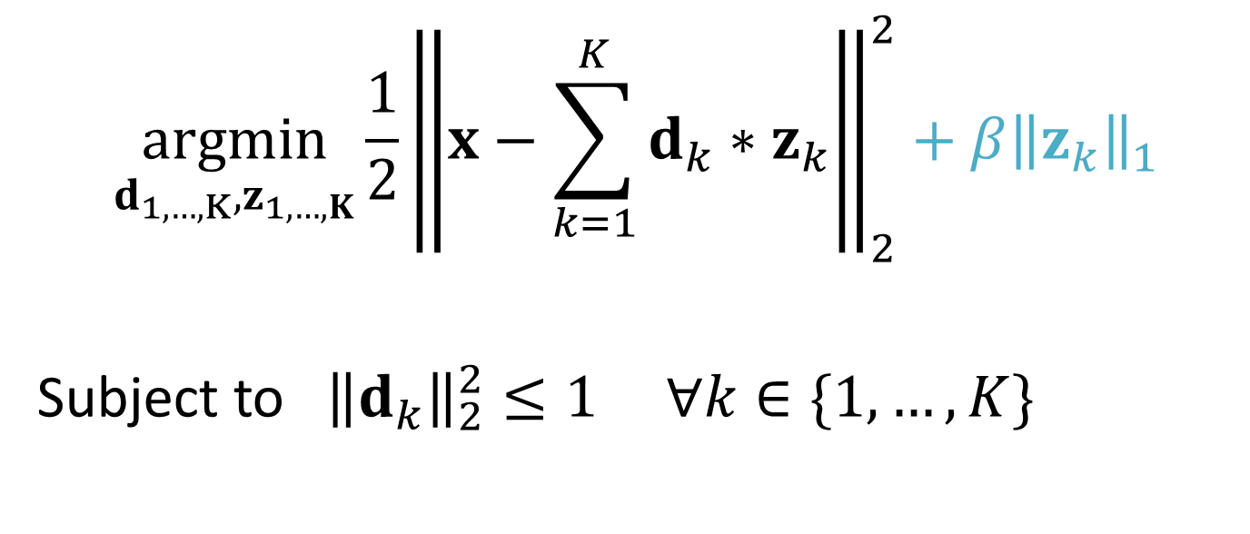
Convolutional Sparse Coding
$$\underset{d_{1,…,K},z_{1,…,K}}{argmin}{\frac{1}{2}{\left\|x−\sum_{k=1}^{K}{d_{k}∗z_{k}}\right\|}_{2}^{2}+{β\left\|z_{k}\right\|}_{1}}$$
Subject to ${\left\|d_{k}\right\|}_{2}^{2}≤1 ∀k∈\{1,…,K\}$
Prevents the dictionary from absorbing all of the system’s energy
Computational complexity
Non-convexity
Notes:
☹ Computational complexity
☹ Non-convexity

Slide 11
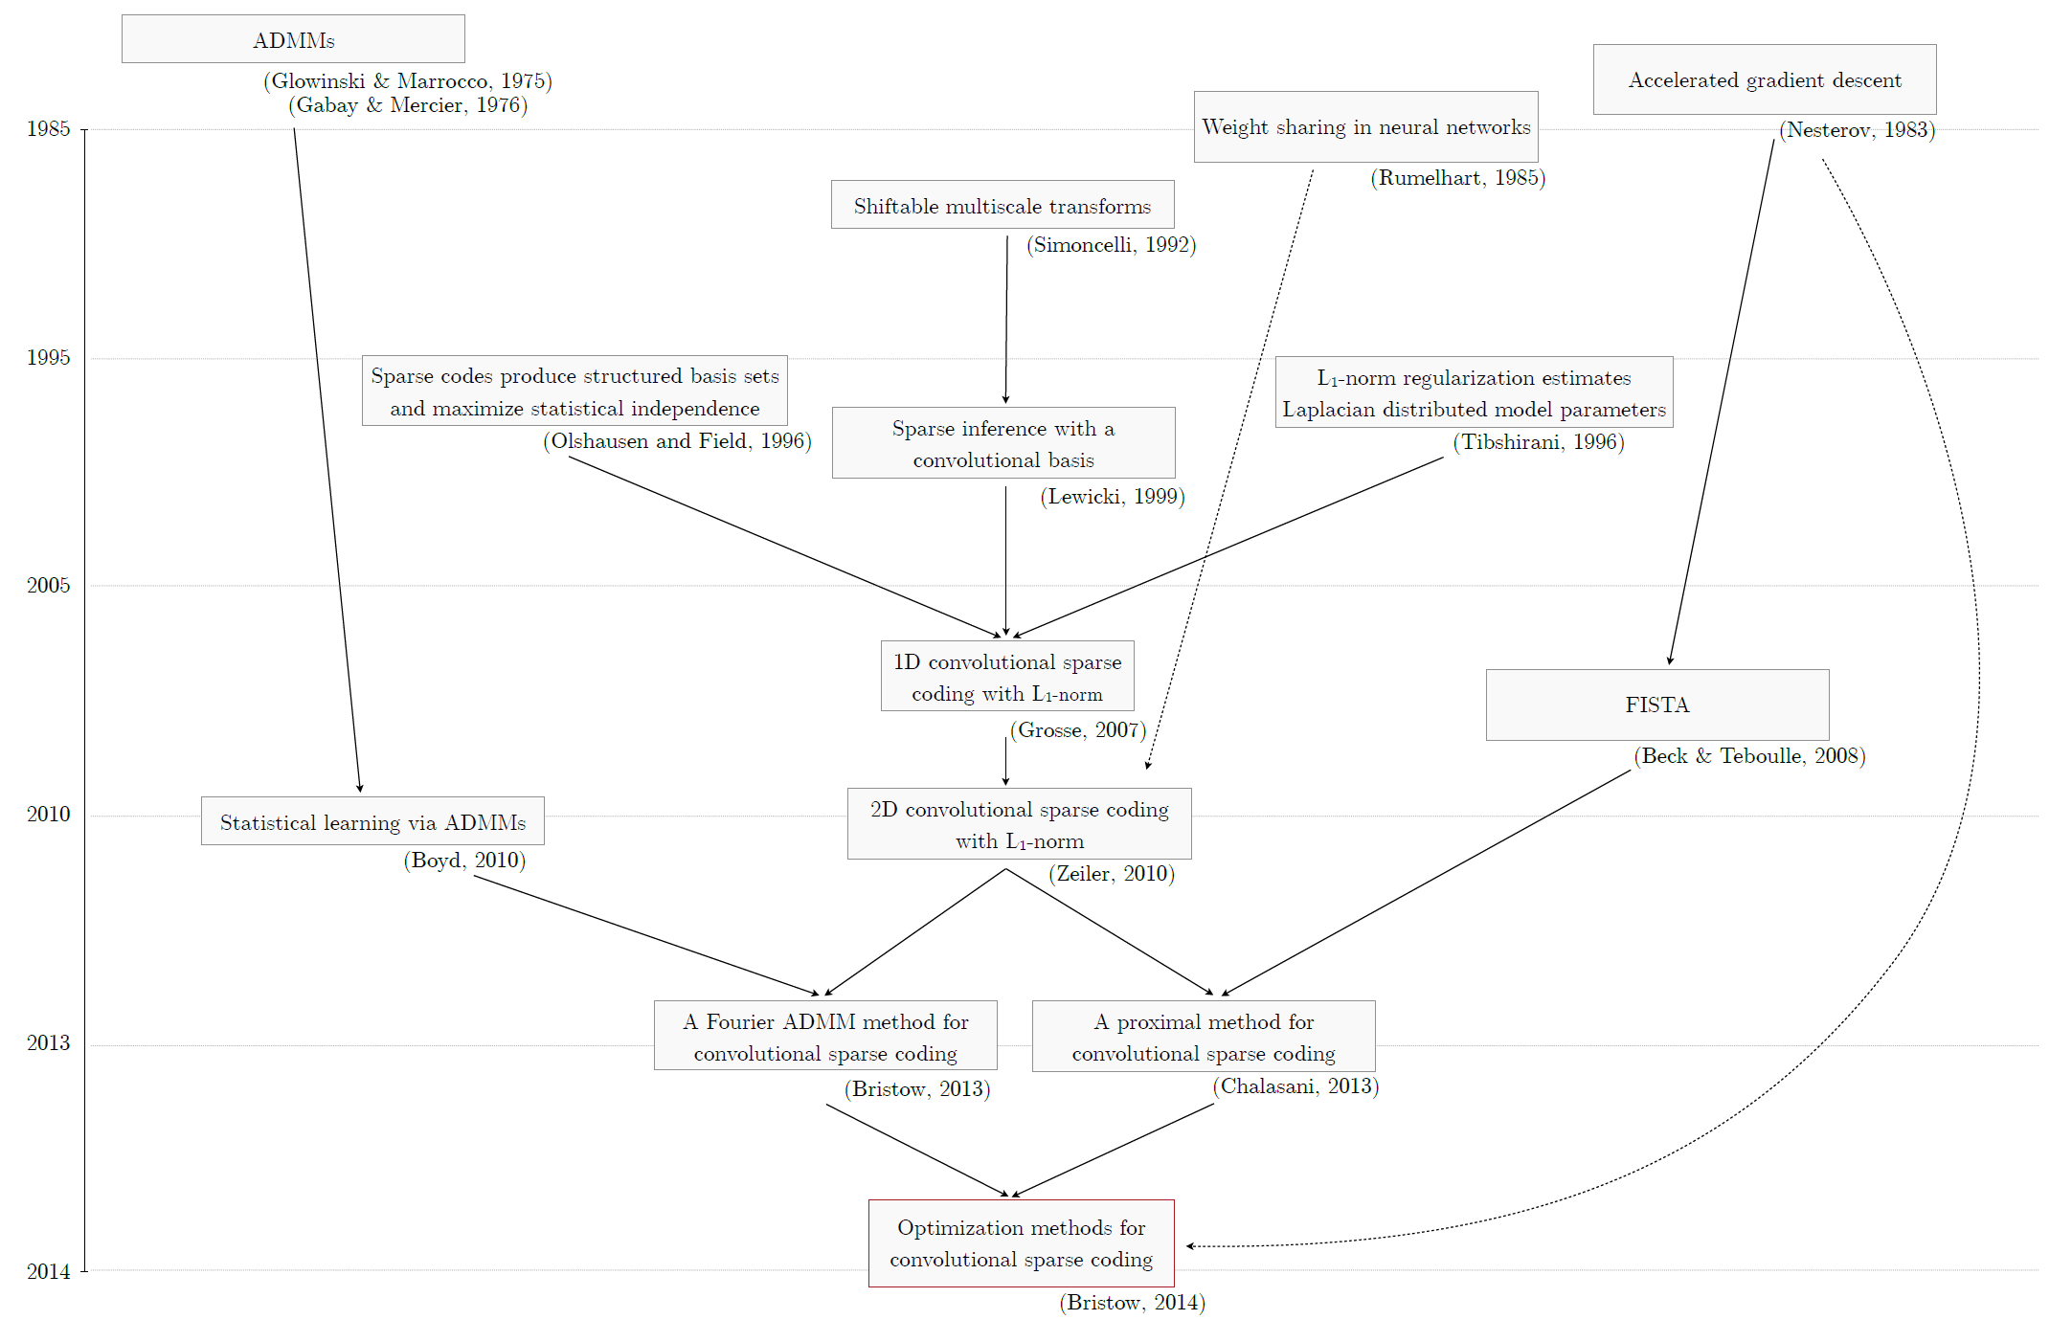
How to Solve the Optimization?
Seminal Advances
- Solving the convolution sub-problem in the Fourier domain
- Using ADMMs
Notes:
I found this picture in a survey about CSC which shows the history of optimization methods for solving CSCs..

Slide 12
How to Solve the Optimization?
Seminal Advances
- Proper Boundary conditions
- Inference from incomplete data
- Faster convergence
2015
Fast and Flexible Convolutional Sparse Coding
(Heide, 2015)
Notes:
Now in this paper more flexible constraints to CSC are added with faster and betters convergence

Slide 13
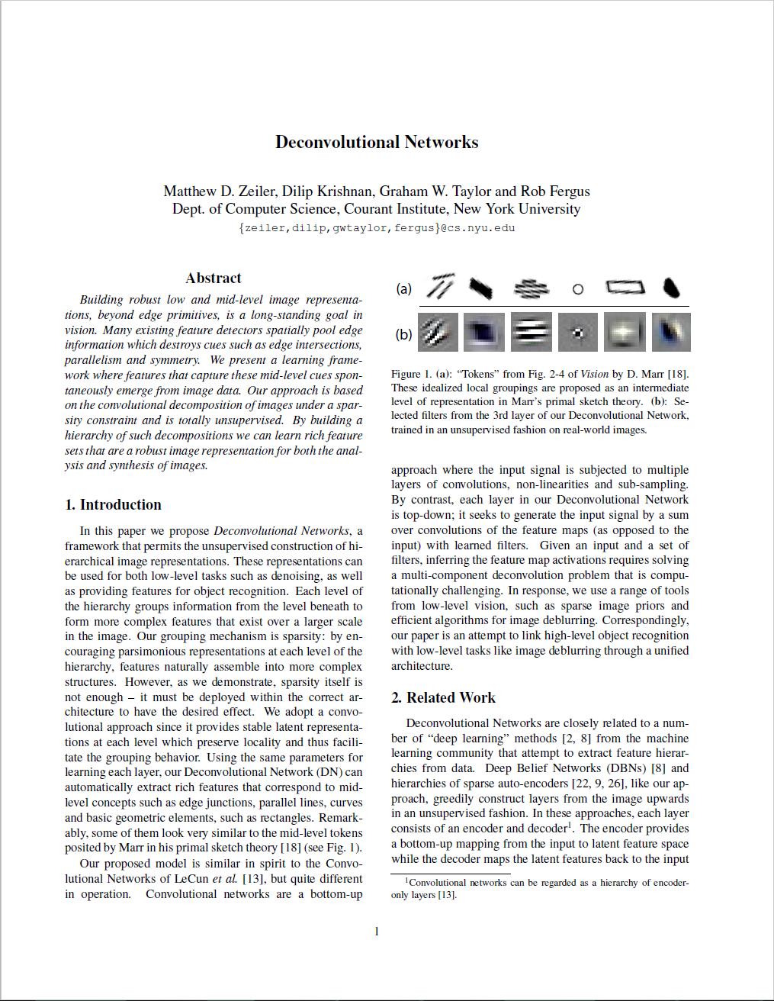
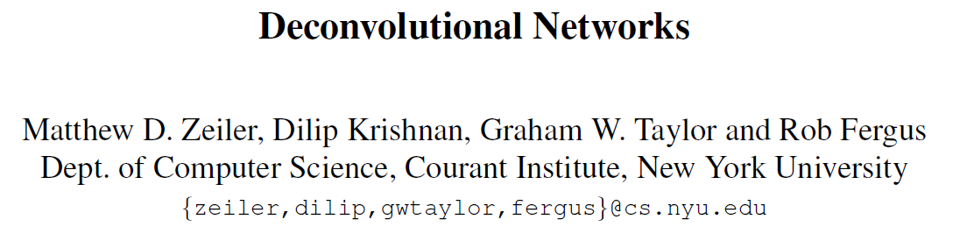
An Approach
CVPR 2010

Slide 14

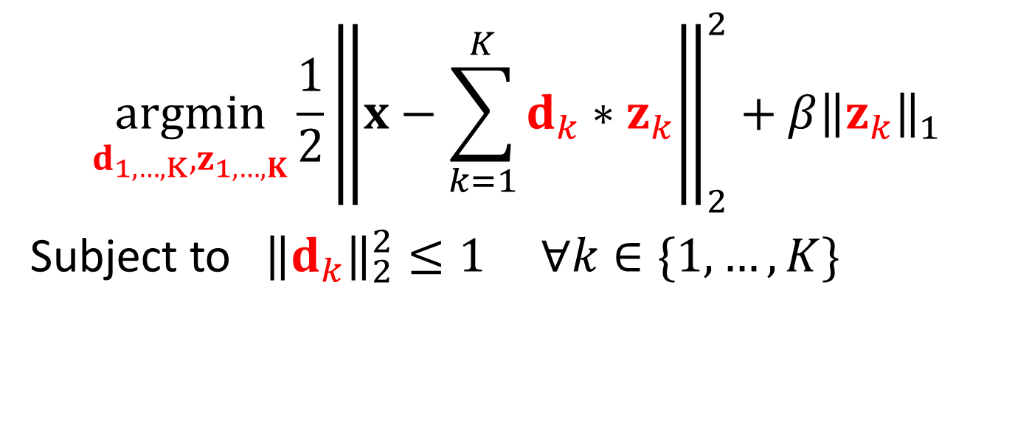
Back to our Objective
$$\underset{d_{1,…,K},z_{1,…,K}}{argmin}{\frac{1}{2}{\left\|x−\sum_{k=1}^{K}{d_{k}∗z_{k}}\right\|}_{2}^{2}+{β\left\|z_{k}\right\|}_{1}}$$
Subject to ${\left\|d_{k}\right\|}_{2}^{2}≤1 ∀k∈\{1,…,K\}$

Slide 15

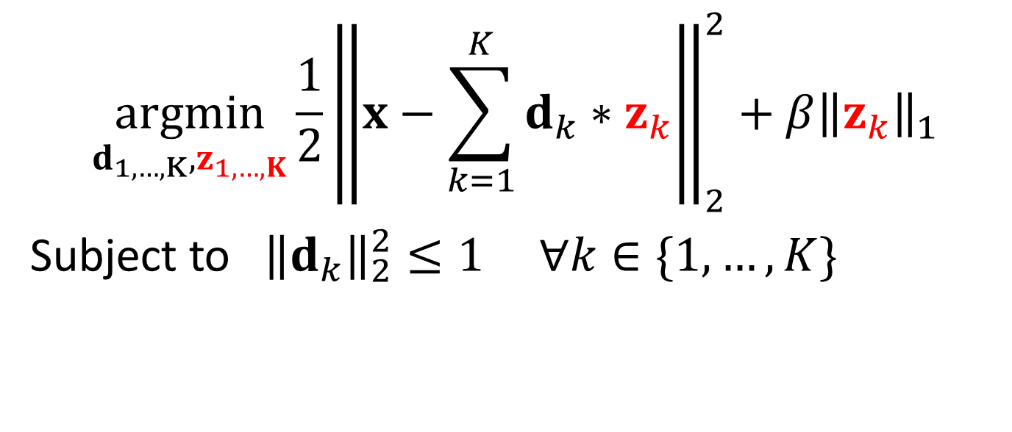
Splitting the Objective
$$\underset{d_{1,…,K},z_{1,…,K}}{argmin}{\frac{1}{2}{\left\|x−\sum_{k=1}^{K}{d_{k}∗z_{k}}\right\|}_{2}^{2}+{β\left\|z_{k}\right\|}_{1}}$$
Subject to ${\left\|d_{k}\right\|}_{2}^{2}≤1 ∀k∈\{1,…,K\}$
Fix $d$, solve for the feature maps $z$
Inferring Feature Maps Step

Slide 16
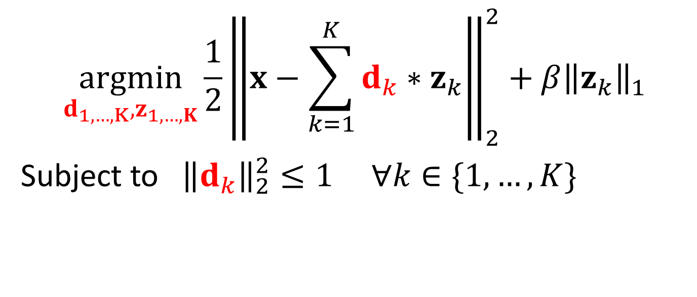
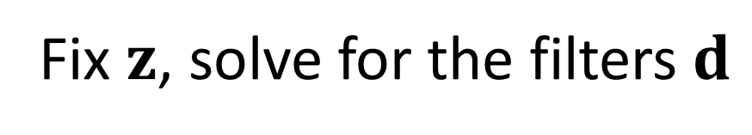
Splitting the Objective
$$\underset{d_{1,…,K},z_{1,…,K}}{argmin}{\frac{1}{2}{\left\|x−\sum_{k=1}^{K}{d_{k}∗z_{k}}\right\|}_{2}^{2}+{β\left\|z_{k}\right\|}_{1}}$$
Subject to ${\left\|d_{k}\right\|}_{2}^{2}≤1 ∀k∈\{1,…,K\}$
Fix $z$, solve for the filters $d$
Filter Update Step

Slide 17
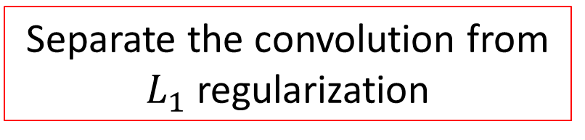
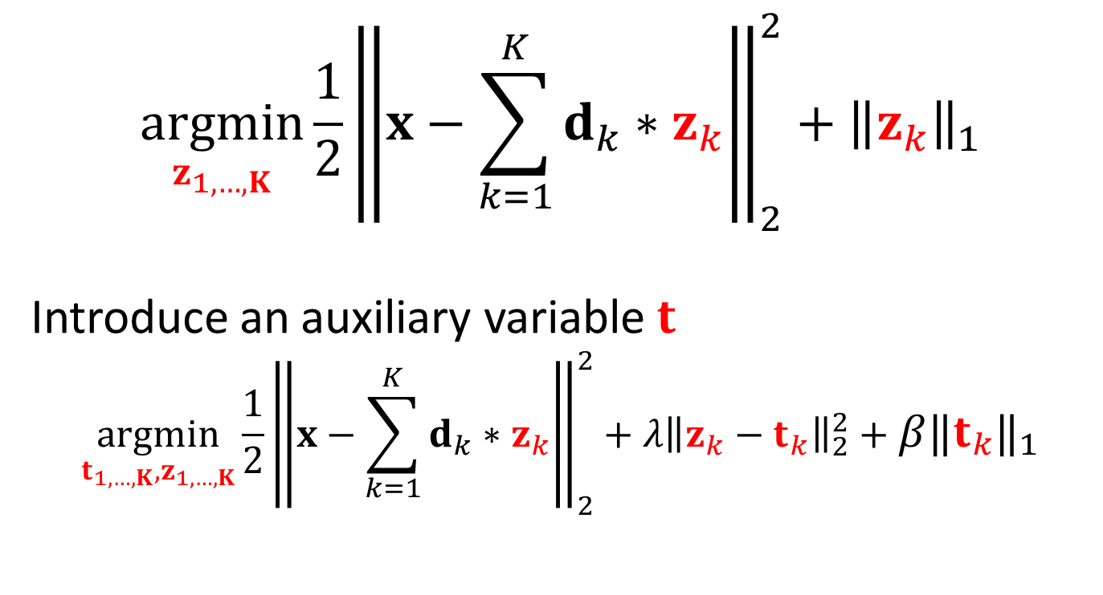
Inferring Feature Maps
$$\underset{z_{1,…,K}}{argmin}{\frac{1}{2}{\left\|x−\sum_{k=1}^{K}{d_{k}∗z_{k}}\right\|}_{2}^{2}+{\left\|z_{k}\right\|}_{1}}$$
Introduce an auxiliary variable $t$
$$\underset{t_{1,…,K},z_{1,…,K}}{argmin}{\frac{1}{2}{\left\|x−\sum_{k=1}^{K}{d_{k}∗z_{k}}\right\|}_{2}^{2}+{λ\left\|z_{k}−t_{k}\right\|}_{2}^{2}}+{β\left\|t_{k}\right\|}_{1}$$
Separate the convolution from $L_{1}$ regularization

Slide 18
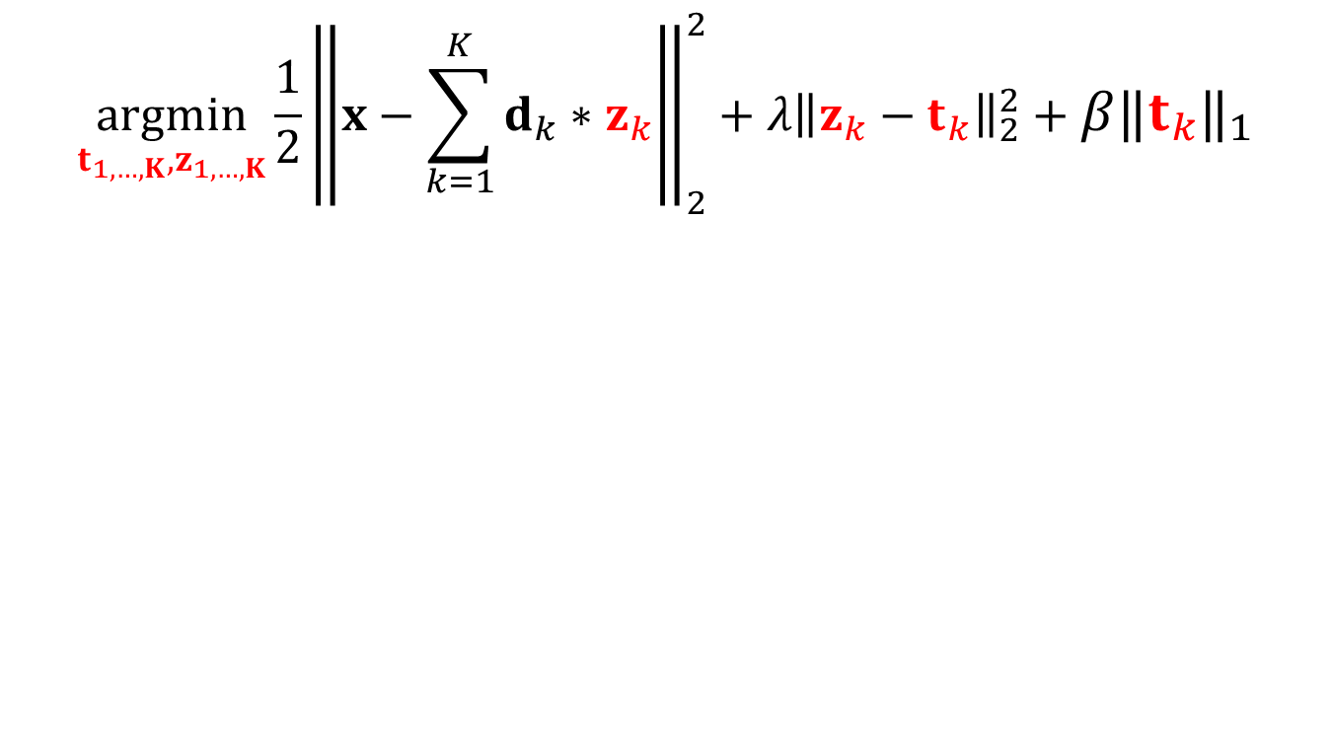
Inferring Feature Maps
$$\underset{t_{1,…,K},z_{1,…,K}}{argmin}{\frac{1}{2}{\left\|x−\sum_{k=1}^{K}{d_{k}∗z_{k}}\right\|}_{2}^{2}+{λ\left\|z_{k}−t_{k}\right\|}_{2}^{2}}+{β\left\|t_{k}\right\|}_{1}$$

Slide 19

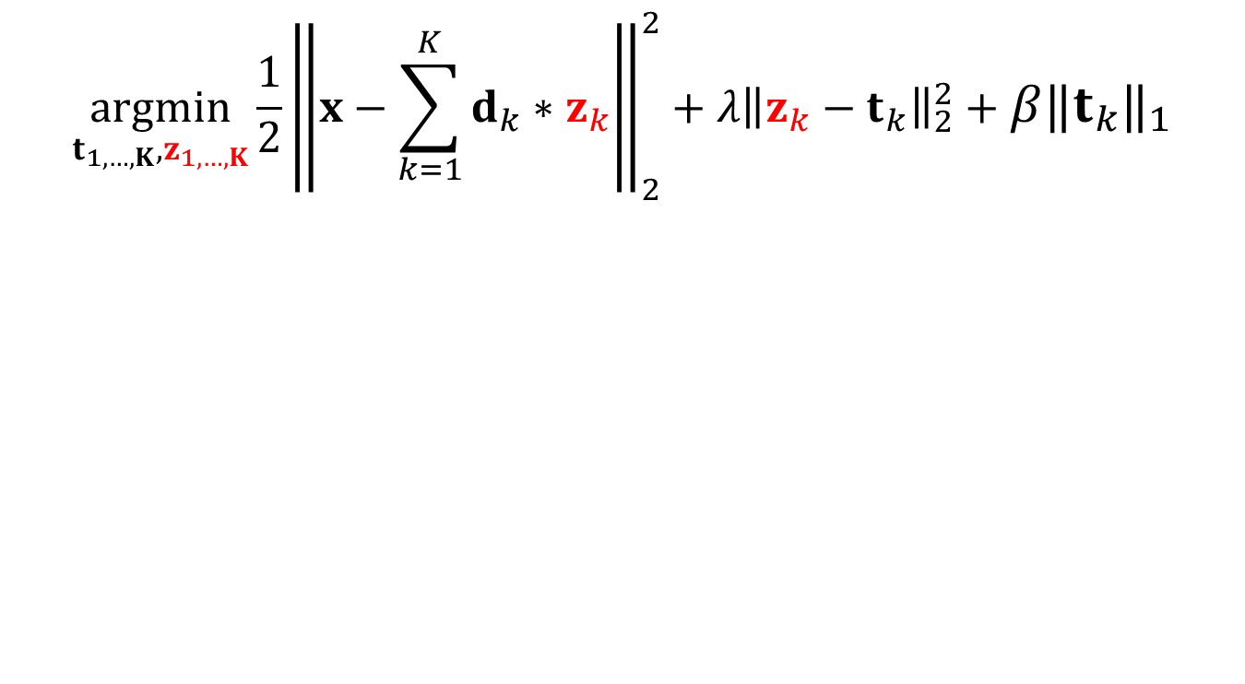

Inferring Feature Maps
$$\underset{t_{1,…,K},z_{1,…,K}}{argmin}{\frac{1}{2}{\left\|x−\sum_{k=1}^{K}{d_{k}∗z_{k}}\right\|}_{2}^{2}+{λ\left\|z_{k}−t_{k}\right\|}_{2}^{2}}+{β\left\|t_{k}\right\|}_{1}$$
Fix $t$, solve for $z$
A quadratic Problem in $z$

Slide 20

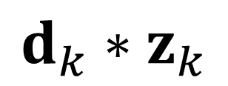
Convolution as Matrix Multiplication
$$d_{k}∗z_{k}$$
1 | 2 | 3 | . | . | . | 7
8
.
. |  |  | .
. |  |  |  | .
 |  |  |  |  | .
 |  |  |  |  |  | 49
1 | 2 | 3
4 | 5 | 6
7 | 8 | 9
$$∗$$
Notes:
Transforming the convolution to matrxi multiplicationa

Slide 21
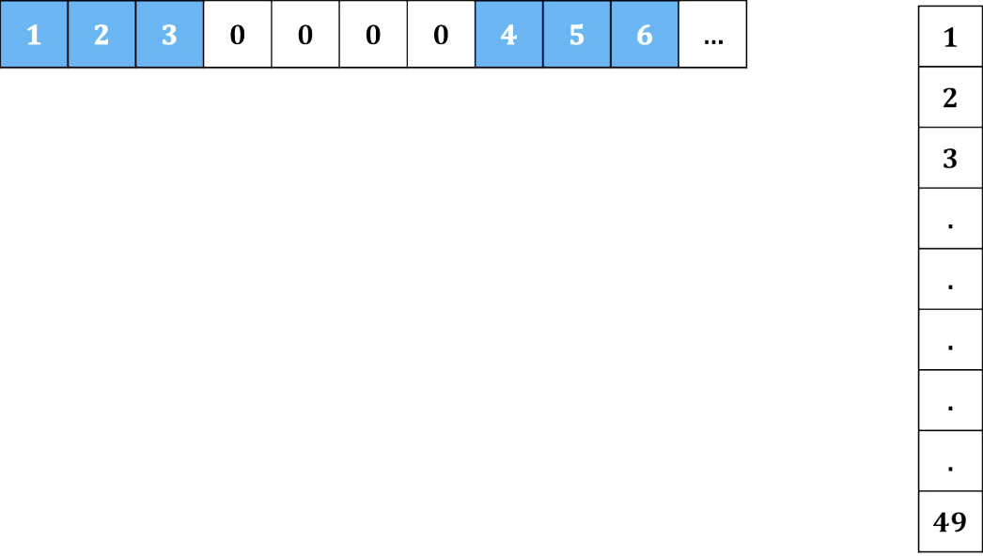
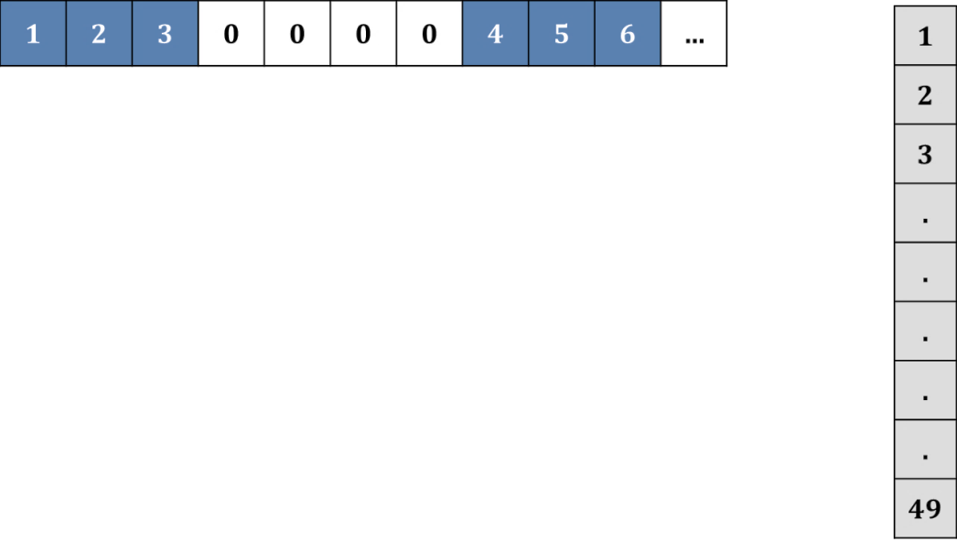

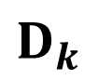
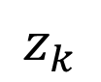
1 | 2 | 3 | . | . | . | 7
8
.
. |  |  | .
. |  |  |  | .
 |  |  |  |  | .
 |  |  |  |  |  | 49
1 | 2 | 3
4 | 5 | 6
7 | 8 | 9
$$z_{k}$$
$$D_{k}$$
Convolution
Matrix
Notes:
Results in Toeplitz matrices and their concatenation is now the new matrix D.

Slide 22
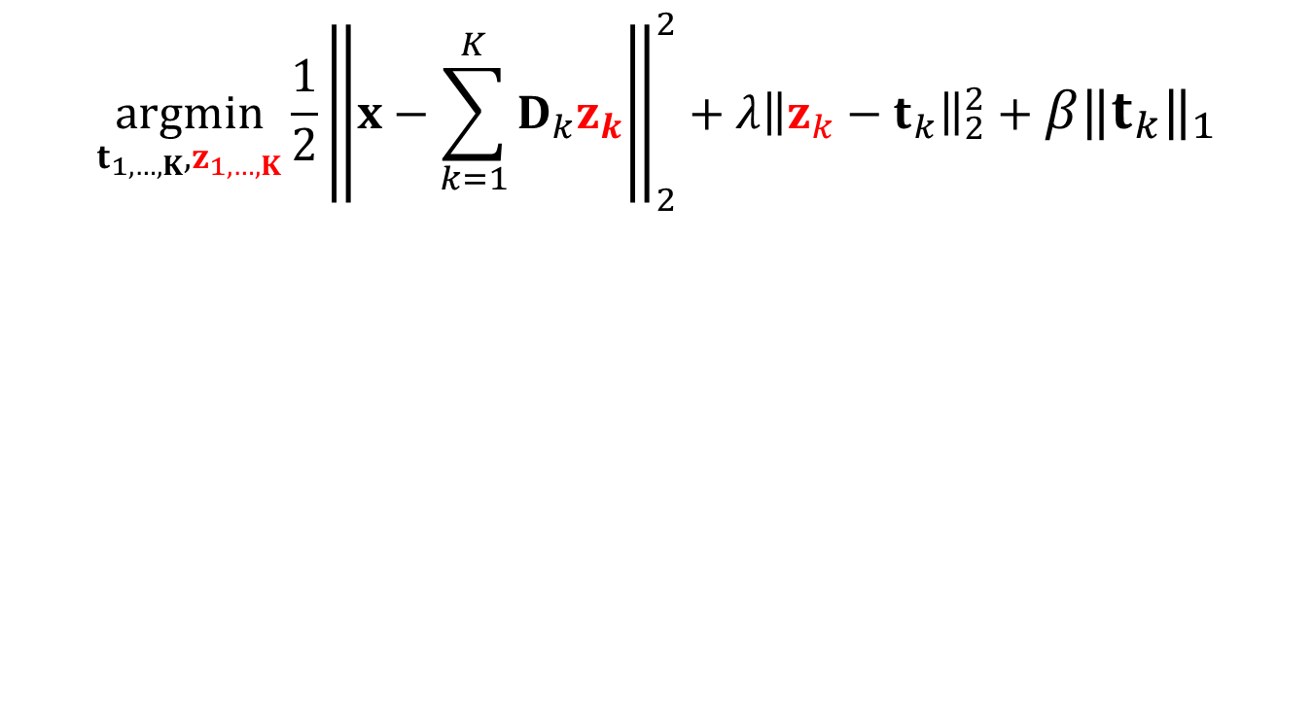
Inferring Feature Maps
$$\underset{t_{1,…,K},z_{1,…,K}}{argmin}{\frac{1}{2}{\left\|x−\sum_{k=1}^{K}{D_{k}z_{k}}\right\|}_{2}^{2}+{λ\left\|z_{k}−t_{k}\right\|}_{2}^{2}}+{β\left\|t_{k}\right\|}_{1}$$
Fix $t$, solve for $z$
A quadratic Problem in $z$
Solved by gradient descent with
gradient direction involving solution to
large linear systems of convolution matrices

Slide 23

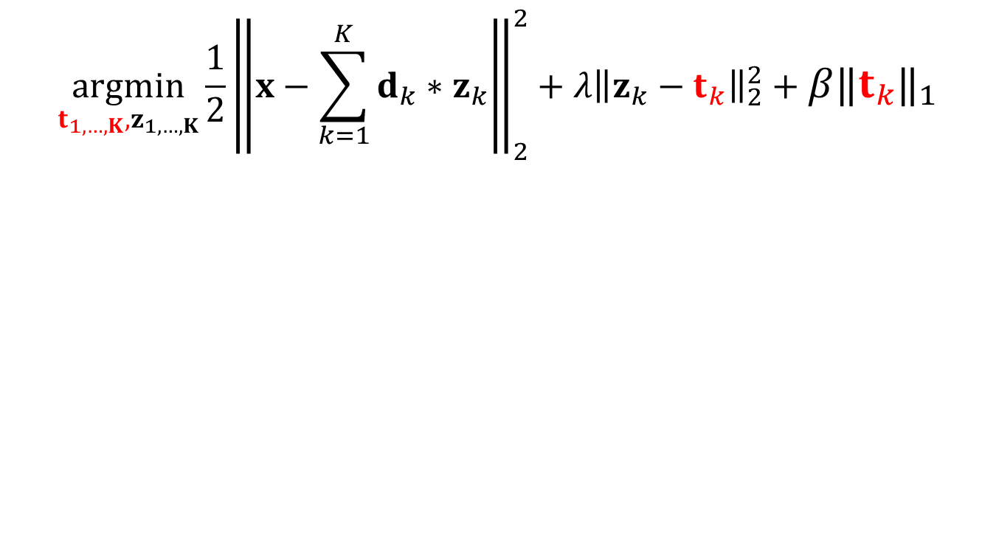
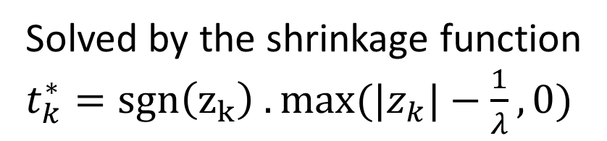

Inferring Feature Maps
$$\underset{t_{1,…,K},z_{1,…,K}}{argmin}{\frac{1}{2}{\left\|x−\sum_{k=1}^{K}{d_{k}∗z_{k}}\right\|}_{2}^{2}+{λ\left\|z_{k}−t_{k}\right\|}_{2}^{2}}+{β\left\|t_{k}\right\|}_{1}$$
Fix $z$, solve for $t$
A separable 1D Problem in $t$
Solved by the shrinkage function
$t_{k}^{∗}=sgn\left(z_{k}\right) .max⁡(|z_{k}|−\frac{1}{λ},0)$

Slide 24

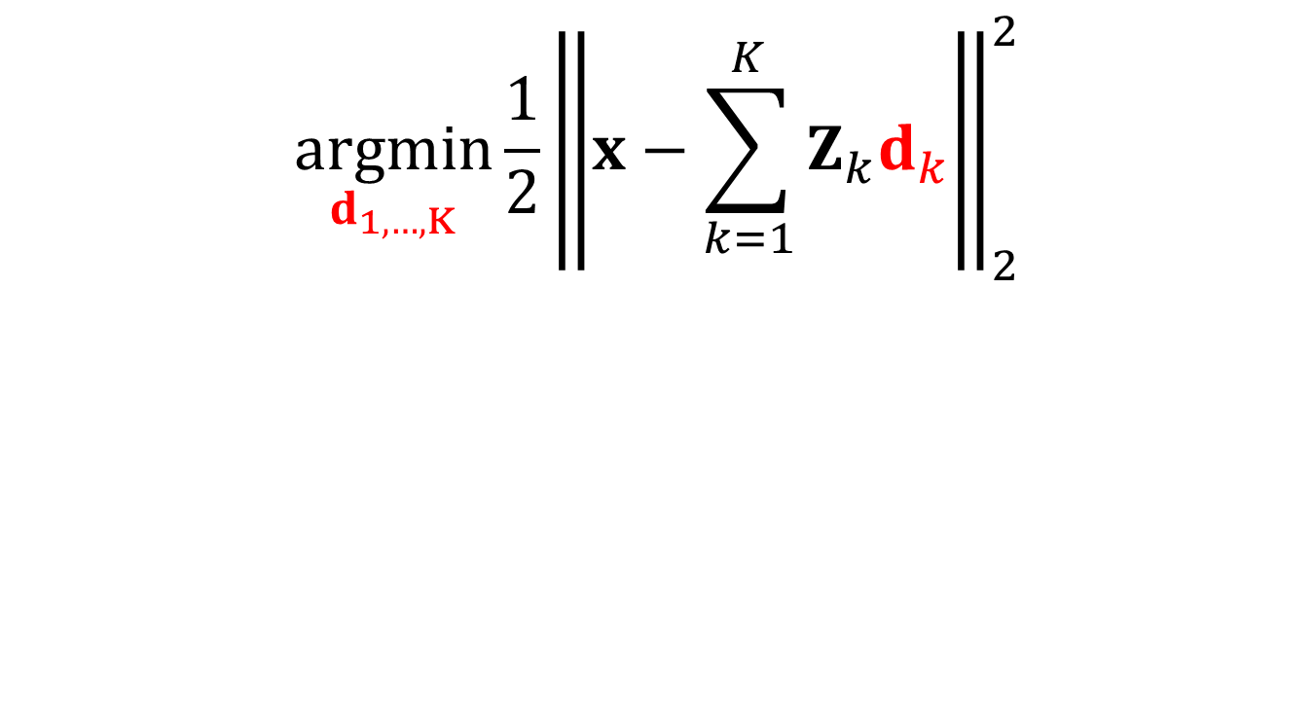
Filter Update
$$\underset{d_{1,…,K}}{argmin}{\frac{1}{2}{\left\|x−\sum_{k=1}^{K}{Z_{k}d_{k}}\right\|}_{2}^{2}}$$
A quadratic Problem in $d$
Solved by gradient descent with
gradient direction involving solution to
large linear system of convolution matrices

Slide 25

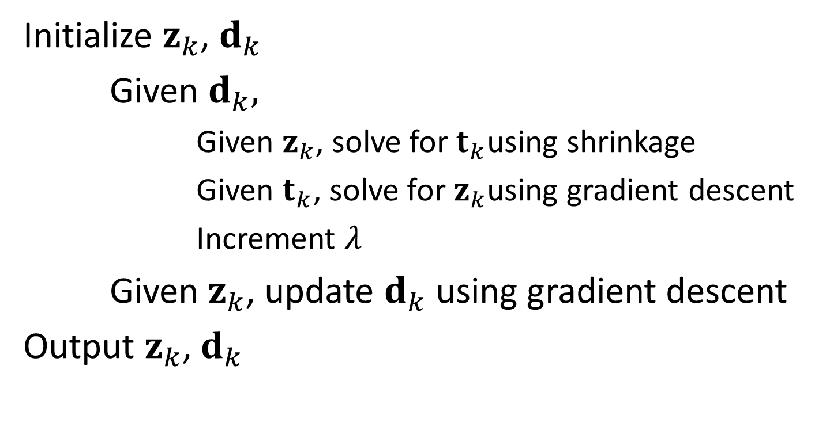


Combining the Steps
Initialize $z_{k}$, $d_{k}$
Given $d_{k},$
Given $z_{k}$, solve for $t_{k}$using shrinkage
Given $t_{k}$, solve for $z_{k}$using gradient descent
Increment $λ$
Given $z_{k}$, update $d_{k}$ using gradient descent
Output $z_{k}$, $d_{k}$
$t$sub-problem
$z$sub-problem
Outer iterations
inner iterations
$d$sub-problem

Slide 26
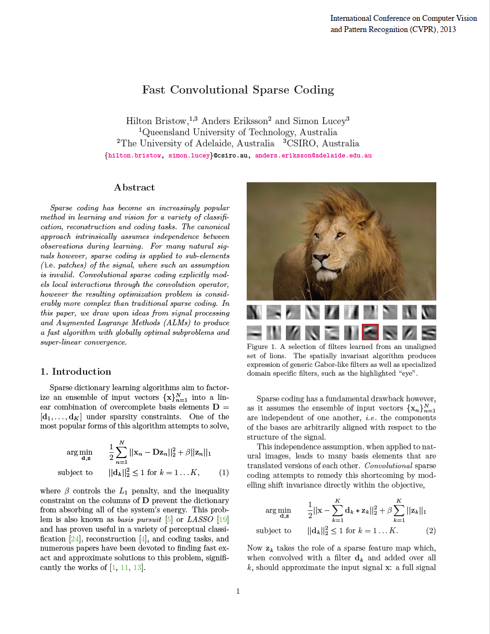
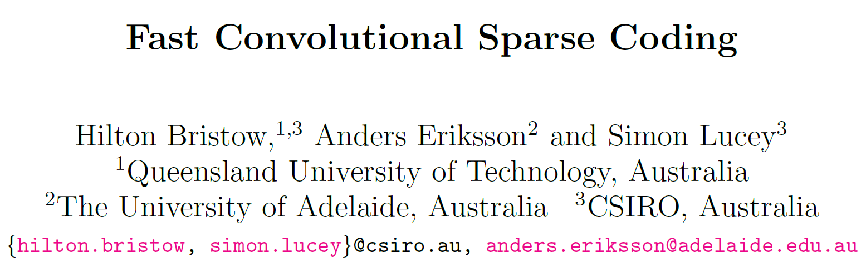
A Faster Approach
CVPR 2013

Slide 27
Back to our Objective
$$\underset{d_{1,…,K},z_{1,…,K}}{argmin}{\frac{1}{2}{\left\|x−\sum_{k=1}^{K}{d_{k}∗z_{k}}\right\|}_{2}^{2}+{β\left\|z_{k}\right\|}_{1}}$$
Subject to ${\left\|d_{k}\right\|}_{2}^{2}≤1 ∀k∈\{1,…,K\}$

Slide 28
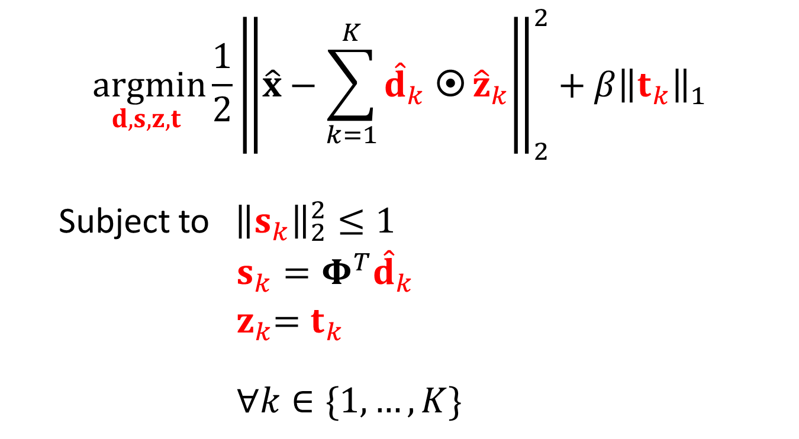
Objective Reformulation
$$\underset{d,s,z,t }{argmin}{\frac{1}{2}{\left\|\hat{x}−\sum_{k=1}^{K}{{\hat{d}}_{k} }{\hat{z}}_{k}\right\|}_{2}^{2}+{β\left\|t_{k}\right\|}_{1}}$$
Subject to ${\left\|s_{k}\right\|}_{2}^{2}≤1$
$s_{k}=Φ^{T}{\hat{d}}_{k}$
${ z}_{k}=t_{k}$
$∀k∈\{1,…,K\}$
Assuming circular boundary conditions…
Notes:
This is the reformulation of the problem which using Fourrier analysis transforms the convolutions into elementwise multiplication, and with the introduction of slack variables, a solution is reached via ADMM

Slide 29
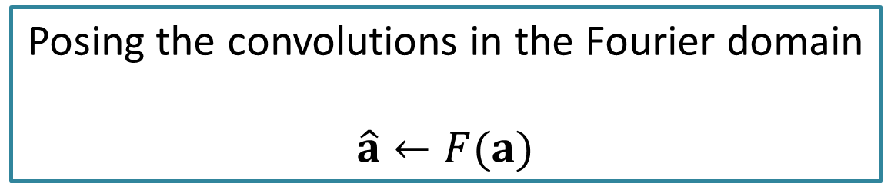
Objective Reformulation
$$\underset{d,s,z,t }{argmin}{\frac{1}{2}{\left\|\hat{x}−\sum_{k=1}^{K}{{\hat{d}}_{k} }{\hat{z}}_{k}\right\|}_{2}^{2}+{β\left\|t_{k}\right\|}_{1}}$$
Subject to ${\left\|s_{k}\right\|}_{2}^{2}≤1$
$s_{k}=Φ^{T}{\hat{d}}_{k}$
${ z}_{k}=t_{k}$
$∀k∈\{1,…,K\}$
Posing the convolutions in the Fourier domain
$$\hat{a}←F(a)$$

Slide 30

Objective Reformulation
$$\underset{d,s,z,t }{argmin}{\frac{1}{2}{\left\|\hat{x}−\sum_{k=1}^{K}{{\hat{d}}_{k} }{\hat{z}}_{k}\right\|}_{2}^{2}+{β\left\|t_{k}\right\|}_{1}}$$
Subject to ${\left\|s_{k}\right\|}_{2}^{2}≤1$
$s_{k}=Φ^{T}{\hat{d}}_{k}$
${ z}_{k}=t_{k}$
$∀k∈\{1,…,K\}$
Auxiliary variable $s_{k}$
$Φ$ allows small spatial support of the filter

Slide 31

Objective Reformulation
$$\underset{d,s,z,t }{argmin}{\frac{1}{2}{\left\|\hat{x}−\sum_{k=1}^{K}{{\hat{d}}_{k} }{\hat{z}}_{k}\right\|}_{2}^{2}+{β\left\|t_{k}\right\|}_{1}}$$
Subject to ${\left\|s_{k}\right\|}_{2}^{2}≤1$
$s_{k}=Φ^{T}{\hat{d}}_{k}$
${ z}_{k}=t_{k}$
$∀k∈\{1,…,K\}$
Auxiliary variable $t_{k}$ to separate the convolution from $L_{1}$ regularization

Slide 32

ADMM Approach
Notes:
Augmented lagrangian

Slide 33





Four Sub-problems
$$d$$

Slide 34

Sub-problem $z$

Slide 35



Sub-problem $z$
A quadratic Problem in $z$

Slide 36

Sub-problem $t$

Slide 37



Sub-problem $t$
A separable 1D Problem in $t$

Slide 38

Sub-problem $d$

Slide 39

Sub-problem $d$
A quadratic Problem in $d$

Slide 40



Sub-problem $s$
QCQP problem in $s$

Slide 41


Combining the Sub-problems
Initialize $z,d,t,s,λ_{s},λ_{t}$
Given $z,s,λ_{s}$, solve for $d$
Given $d$, solve for $s$
Given $d,t,λ_{t}$, solve for $z$
Given $z,λ_{t}$, solve for $t$
Update Lagrange multipliers
Output $z$, $d$

Slide 42



Convergence Results

Slide 43


A More Flexible Approach
CVPR 2015

Slide 44
Back to our Objective
$$\underset{d_{1,…,K},z_{1,…,K}}{argmin}{\frac{1}{2}{\left\|x−\sum_{k=1}^{K}{d_{k}∗z_{k}}\right\|}_{2}^{2}+{β\left\|z_{k}\right\|}_{1}}$$
Subject to ${\left\|d_{k}\right\|}_{2}^{2}≤1 ∀k∈\{1,…,K\}$

Slide 45


More General Formulation
$$\underset{d_{1,…,K},z_{1,…,K}}{argmin}{\frac{1}{2}{\left\|x−M\sum_{k=1}^{K}{d_{k}∗z_{k}}\right\|}_{2}^{2}+{β\left\|z_{k}\right\|}_{1}}$$
Subject to ${\left\|d_{k}\right\|}_{2}^{2}≤1 ∀k∈\{1,…,K\}$
Block diagonal matrix $M$ allows for
unmodified filters in boundary regions
Efficient learning and reconstruction from incomplete data
Cannot be solved directly with the Fourier trick…
Notes:
By introducing the matrix M, this adds constraints on the boundary regions. And it allows for efficient learning and reconstruction from incomplete data. However, this generalization makes it impossible to solve directly with the fourrier trick. Noctice that this is similar to the formulation of the optimization reached in the previous paper. The difference is that there d/h was given.

Slide 46




Efficient Splitting of Objective
move the constraints to the objective
Concatenation of convolutional matrices
Notes:
Now bymoving the constraints to the objecive, it can be expressed as a sum of functions while concatenating z and reformulating the convolution as a matrix multiplication.

Slide 47


Generalization of Objective
Selects i^{th} support of v
Notes:
Now we have a sum of functions that we need to solve. This can be reformulated more generally as such where the stacked matrix K allows remap the objective to existing optimization frameworks such as ADMM.

Slide 48




ADMM Approach
0
$$f$$
$$K$$
Notes:
In general ADMMs can be solved by this iterative algorithm.

Slide 49


ADMM for CSC
2
3

Slide 50



Alternating for the biconvex problem
ADMM for $d$
inner iterations
outer iterations
ADMM for $z$
inner iterations

Slide 51


Convergence Results

Slide 52

Filter Learning

Slide 53



Complexity per Outer Iteration
Number of inner iterations
Number of images
Number of filters
Image size
Filter size
Zeiler et al.
Bristow et al.
Heide et al.
($K>N$)
Heide et al.
($K≤N$)

Slide 54

Computer Vision Applications
Image and video compression
A basis for natural images
Structure from motion
Mid-level generative parts
Single image super-resolution
Visualizing object detection features

Slide 55

MultiLayer CSC

Slide 56


Inpainting
Reconstruction Quality

Slide 57



Façade Parsing

Slide 58





CSC and CRF Learning for Urban Asset Detection
Convolutional Sparse Coding
CRF learning

Slide 59
Learned dictionary and Feature Maps

Slide 60




Qualitative Results
Input
sky
shop
wall
roof
window
balcony
chimney
door

Slide 61


Low Rankness Prior
Add a prior on the feature maps to be low rank
Use the nuclear norm as a convex approximation to the rank function
$$+α\sum_{k=1}^{K}{{\left\|z_{k}\right\|}_{∗}}$$
Nuclear Norm

Slide 62


Adding the nuclear norm function
$$+α\sum_{k=1}^{K}{{\left\|z_{k}\right\|}_{∗}}$$
$$+f_{4}(z_{k}))$$
Notes:
Now bymoving the constraints to the objecive, it can be expressed as a sum of functions while concatenating z and reformulating the convolution as a matrix multiplication.

Slide 63


Proximal Operator for Nuclear Norm
$$prox_{θf_{4}}\left(v\right) = \sum_{i=1}^{n}{\left(σ_{i}−θ\right)+a_{i}b_{i}^{T}}$$
Singular Value Thresholding
where $v=\sum_{i=1}^{n}{σ_{i}a_{i}b_{i}^{T}}$

Slide 64
Nuclear Norm
90
10
80
9
Sparse + Low Rank
Sparse
70
8
m
7
60
r
o
n
r
6
a
50
e
l
c
u
5
n
40
e
g
a
4
r
e
v
30
a
3
20
2
10
1
0
0
1
2
3
4
5
6
7
8
9
10
0
0
10
20
30
40
50
60
70
80
90
100
average nuclear norm
kernel number

Slide 65
Dictionary
sparse
Sparse + low rank

Slide 66


Window Detection Results
sparse
Sparse + low rank

Slide 67






Stroke Extraction

Slide 68






Stroke Extraction

Slide 69

Sketch Reconstruction

Slide 70
Thank You

